Slide 1
Predictive Linear Regression Modeling with Streamlit: Penguin Body Mass
By: Haniy Banti, Taddeo Carpinelli, Lucía Lafée, Eissa Oudah, and Sebastián Zambrano
MBD-SEP 2024 Section 1 Group 9

Slide 2
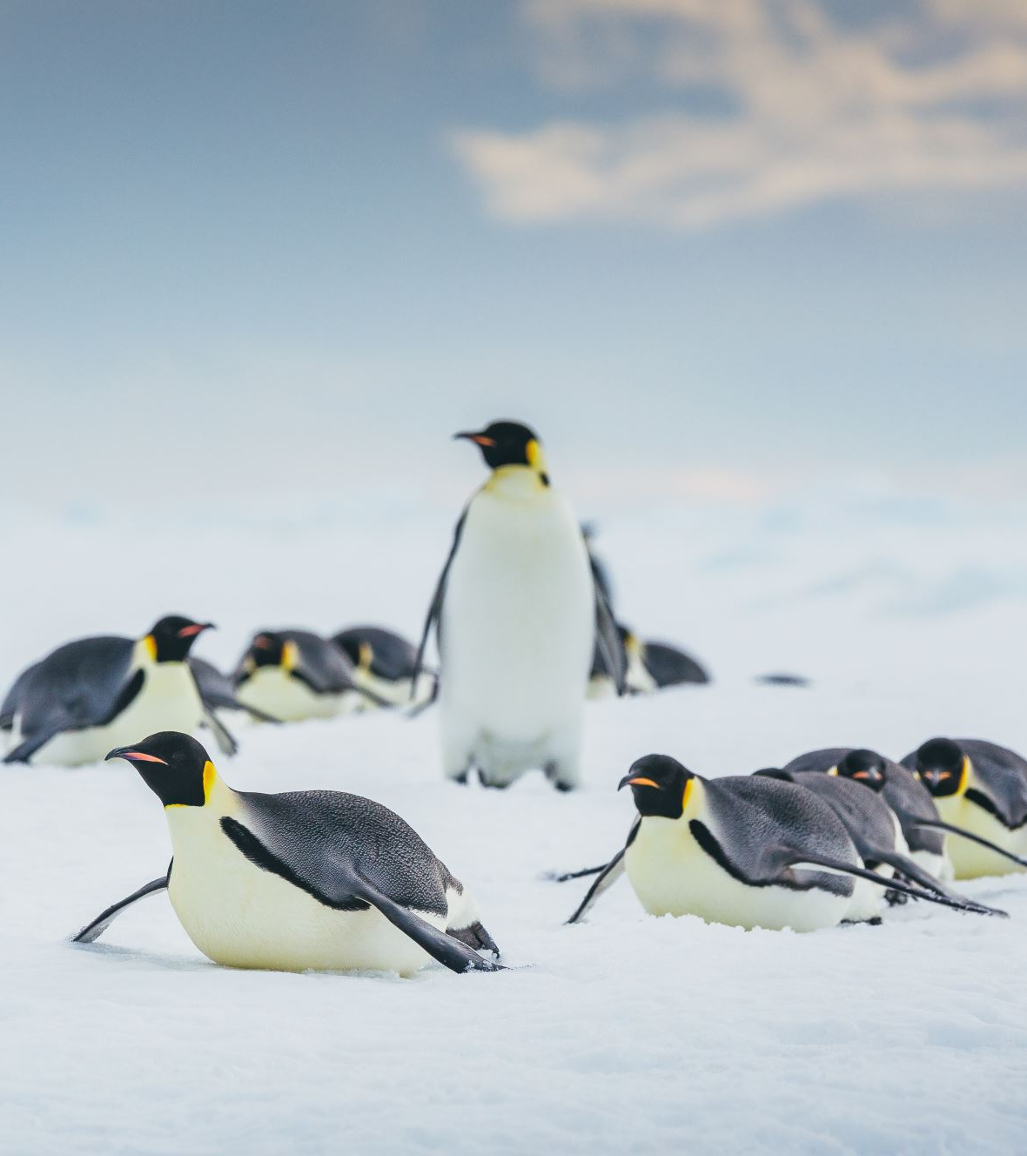
Project Overview
Objective: Develop an interactive Streamlit web app using linear regression to predict penguin body mass based on physical characteristics.
Dataset: The dataset contains information about different species of penguins. It includes measurements, such as bill length, bill depth, flipper length, body mass, and gender.

Slide 3
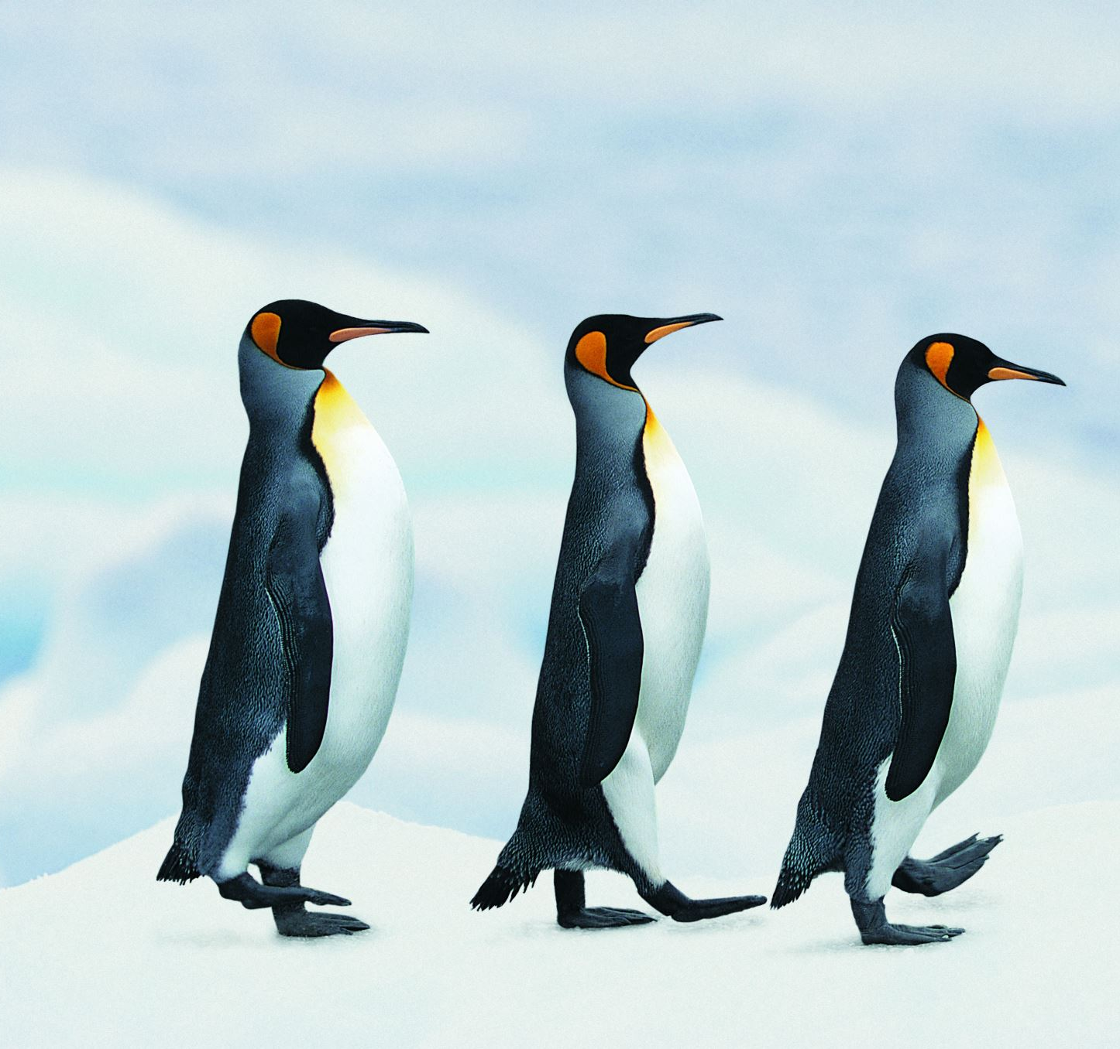
Business Questions & Objectives
Key Business Questions
Is there a relationship between the physical characteristics of penguins and their body mass?
How strong is the relationship between features like species, bill length, flipper length, and body mass?
Which features contribute the most to predicting a penguin's body mass?
How accurately can we estimate a penguin’s weight using regression?
Project Goals
Build a predictive model that answers these questions with empirical data.
Use insights to assist in ecological research and species management.

Slide 4
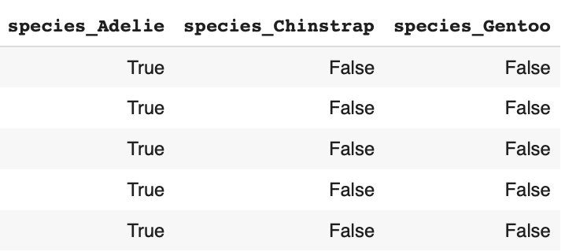
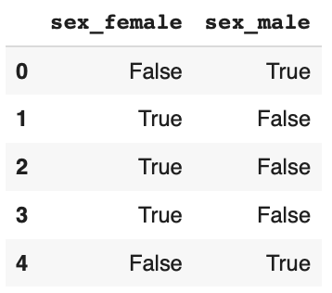
Data Preparation - Exploratory Data Analysis (EDA)
Importing Libraries & Loading Data:
Libraries: pandas, numpy, seaborn, matplotlib, sklearn.
Initial data inspection using info() and describe() to understand data types and distributions.
Exploratory Data Analysis (EDA):
Checked for missing values and ensured clean data for modeling (none found).
Explored basic statistics (mean, min, max) and data types to confirm appropriate handling of numerical and categorical features as well as potential outliers.
Encoding Categorical Variables:
Applied one-hot encoding to transform the species and sex features into binary columns.
Example: Adelie, Chinstrap, Gentoo → [1, 0, 0], [0, 1, 0], [0, 0, 1].
Example: Male, Female → [1, 0]
Removed non-essential columns (island) to simplify the model.
This allows the model to recognize species and sex’ influence on body mass, confirming the previous slide.

Slide 5
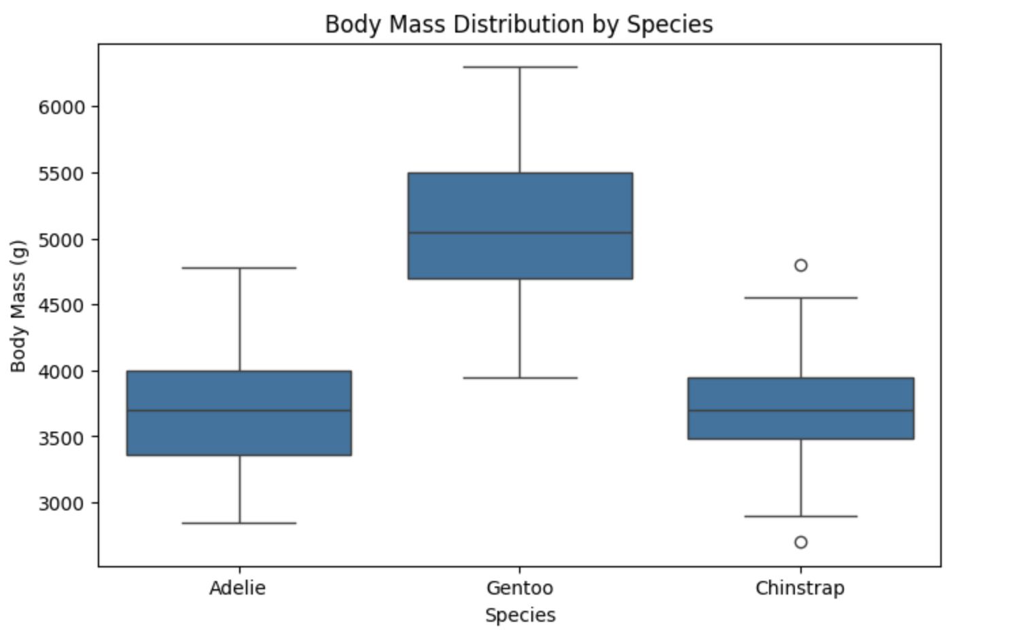
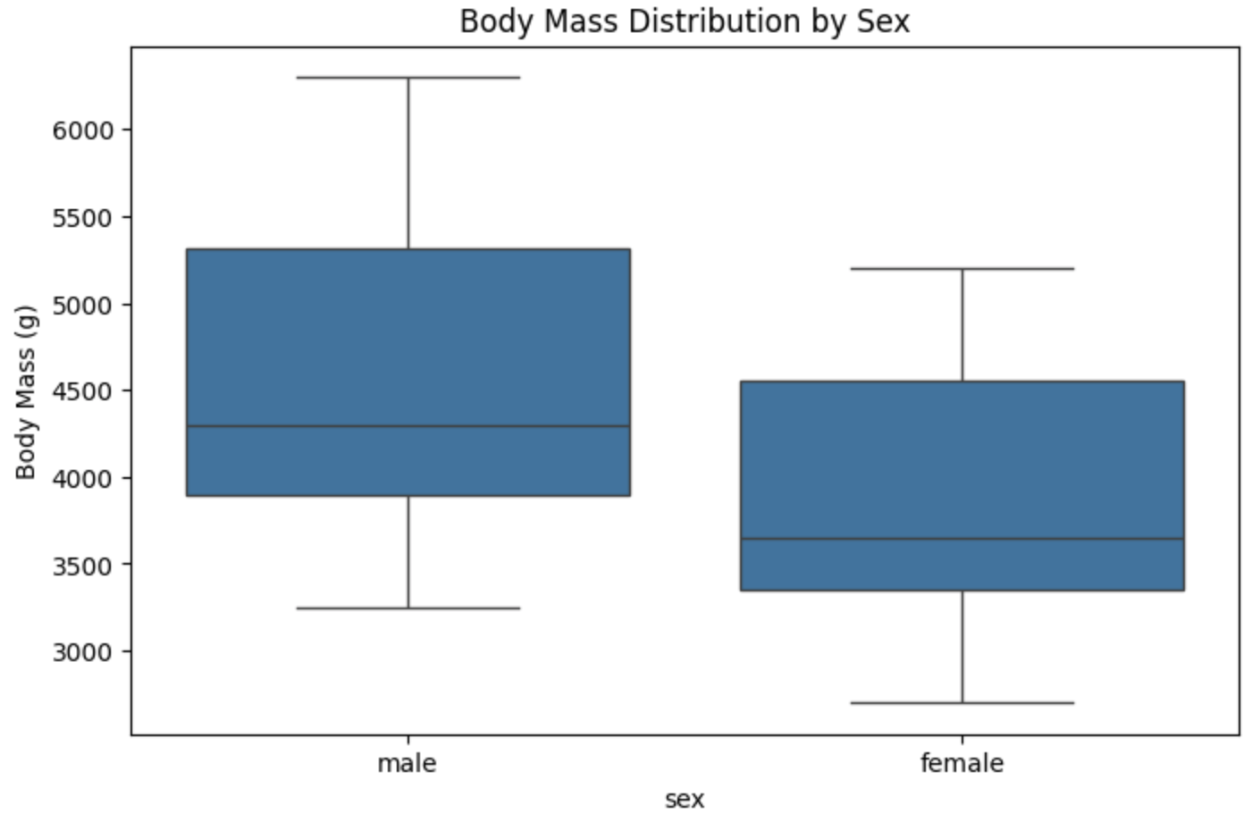
Visualizations of the Effect of Species and Sex on Body Mass
Visualizing Species Impact on Body Mass
Used a box plot to observe how species affect body mass.
Key Findings:
Gentoo species exhibited the highest body mass (~4000g to 6000g+).
Adelie species had moderate body mass (~3000g to 4500g).
Chinstrap species had the lowest body mass (~3000g to 4000g).
Conclusion: Species significantly impacts body mass and should be included as a feature.
Visualizing Gender Impact on Body Mass
Used a box plot to observe how gender affect body mass.
Key Findings:
Male penguins have a higher body mass on average, with values (~3500g to 6000g+).
Female penguins tend to have a lower body mass distribution, mostly between (~3000g to 5000g).
Conclusion: This visualization confirms that sex has a strong impact on body mass. Therefore, it is beneficial to encode this categorical variable in our model.

Slide 6
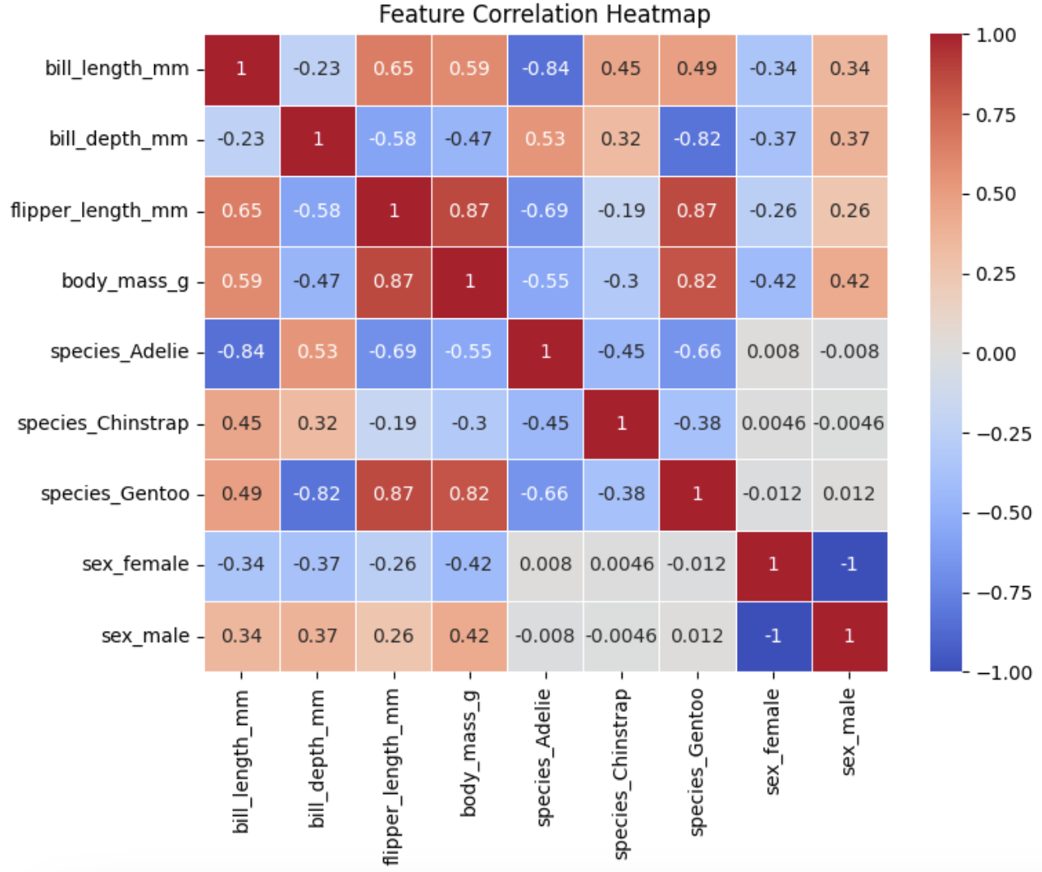
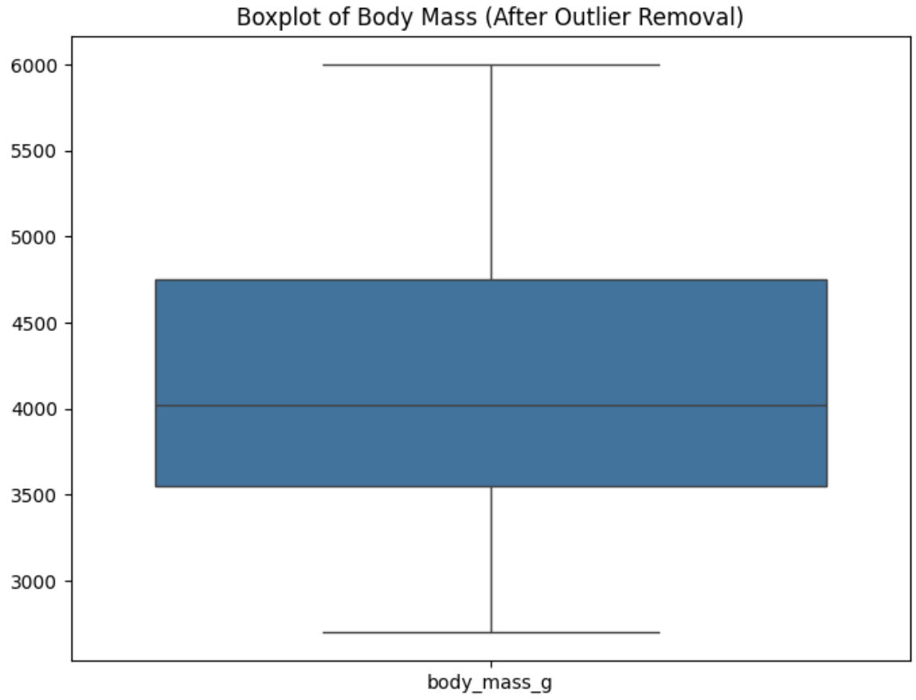
Correlation and Outliers
Feature Correlation Analysis
Created a heatmap to identify a correlation between all features.
Features with very low correlation to body may not be useful.
Strong correlation between bill length, flipper length, sex, and body mass.
Species and sex found to significantly impact body mass.
Detecting & Removing Outliers
Used boxplots and Interquartile Range (IQR) to detect outliers.
Any values outside 1×IQR range were removed to ensure better model accuracy.
From 333 original rows, there are 330 remaining rows after outlier removal.

Slide 7
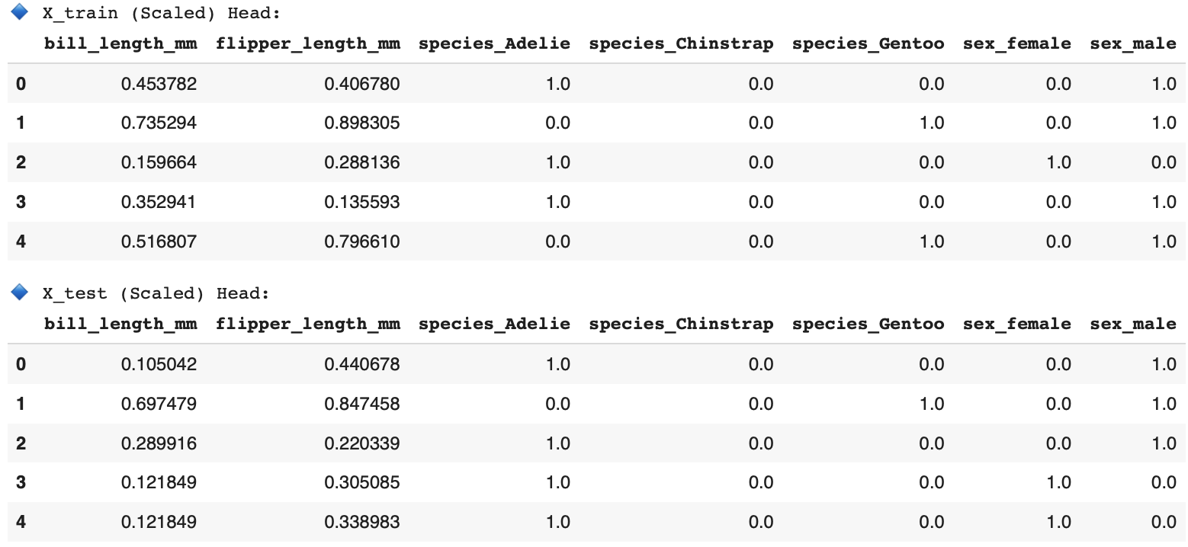
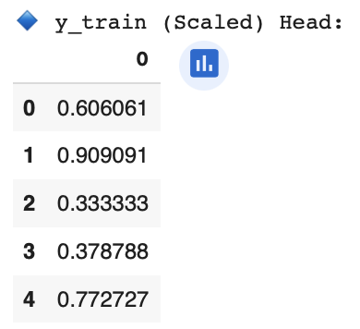
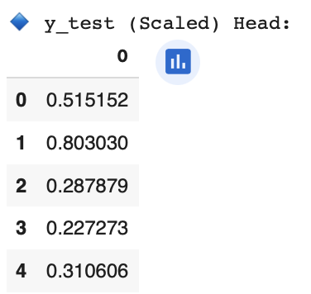
Model Training & Feature Scaling
Splitting Data into Train & Test Sets
To evaluate the model fairly, we split the dataset:
80% training data (for learning patterns)
(264, 7)
20% test data (for model evaluation)
(66, 7)
Feature Scaling (Min-Max Normalization)
Since our features (bill length, flipper length, etc.) have different scales, we apply Min-Max Scaling:
Transforms data to a standard range (0 to 1).
Improves model performance by ensuring all features have equal weight.

Slide 8
Model Building & Evaluation
Model: Linear regression trained on normalized data.
Key Features:
Bill Length (mm)
Flipper Length (mm)
Species (One-Hot Encoded)
Model Performance Metrics:
Mean Squared Error (MSE): 0.007
Root Mean Squared Error (RMSE): 0.082
Mean Absolute Error (MAE): 0.066
R-Squared (R²): 0.876
Sex (One-Hot Encoded)

Slide 9
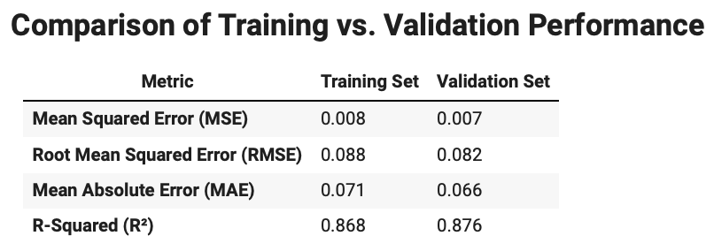
Model Performance Analysis: Overfitting Check
Does this linear regression model overfit?
No, the model is NOT overfitting! because…
The training and validation scores are very close, meaning the model generalizes well to unseen data.
R² values are similar (0.868 vs. 0.876), indicating consistent predictive power.
Errors (MSE, RMSE, MAE) are comparable, confirming that the model does NOT memorize the training data.
Validation set performs slightly better than training, which is unusual, but NOT a concern.

Slide 10

Streamlit Web App Development
Application Overview
Developed a user-friendly Streamlit app for predicting penguin body mass.
Features:
Input fields for bill length, flipper length, species, and sex selection.
Instant prediction of a penguin’s body mass.
Display of model performance metrics (MSE, RMSE, MAE, R²).

Slide 11
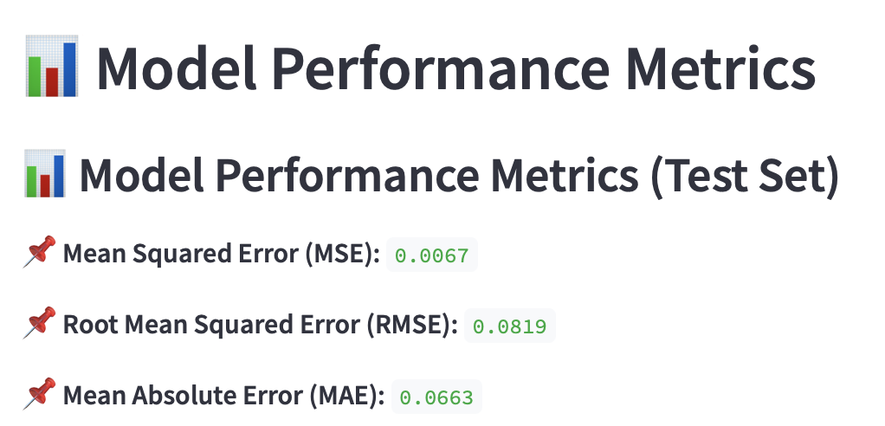
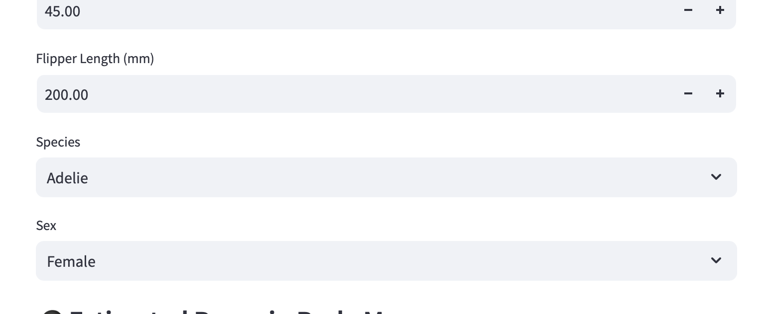
Streamlit App Demonstration

Slide 12
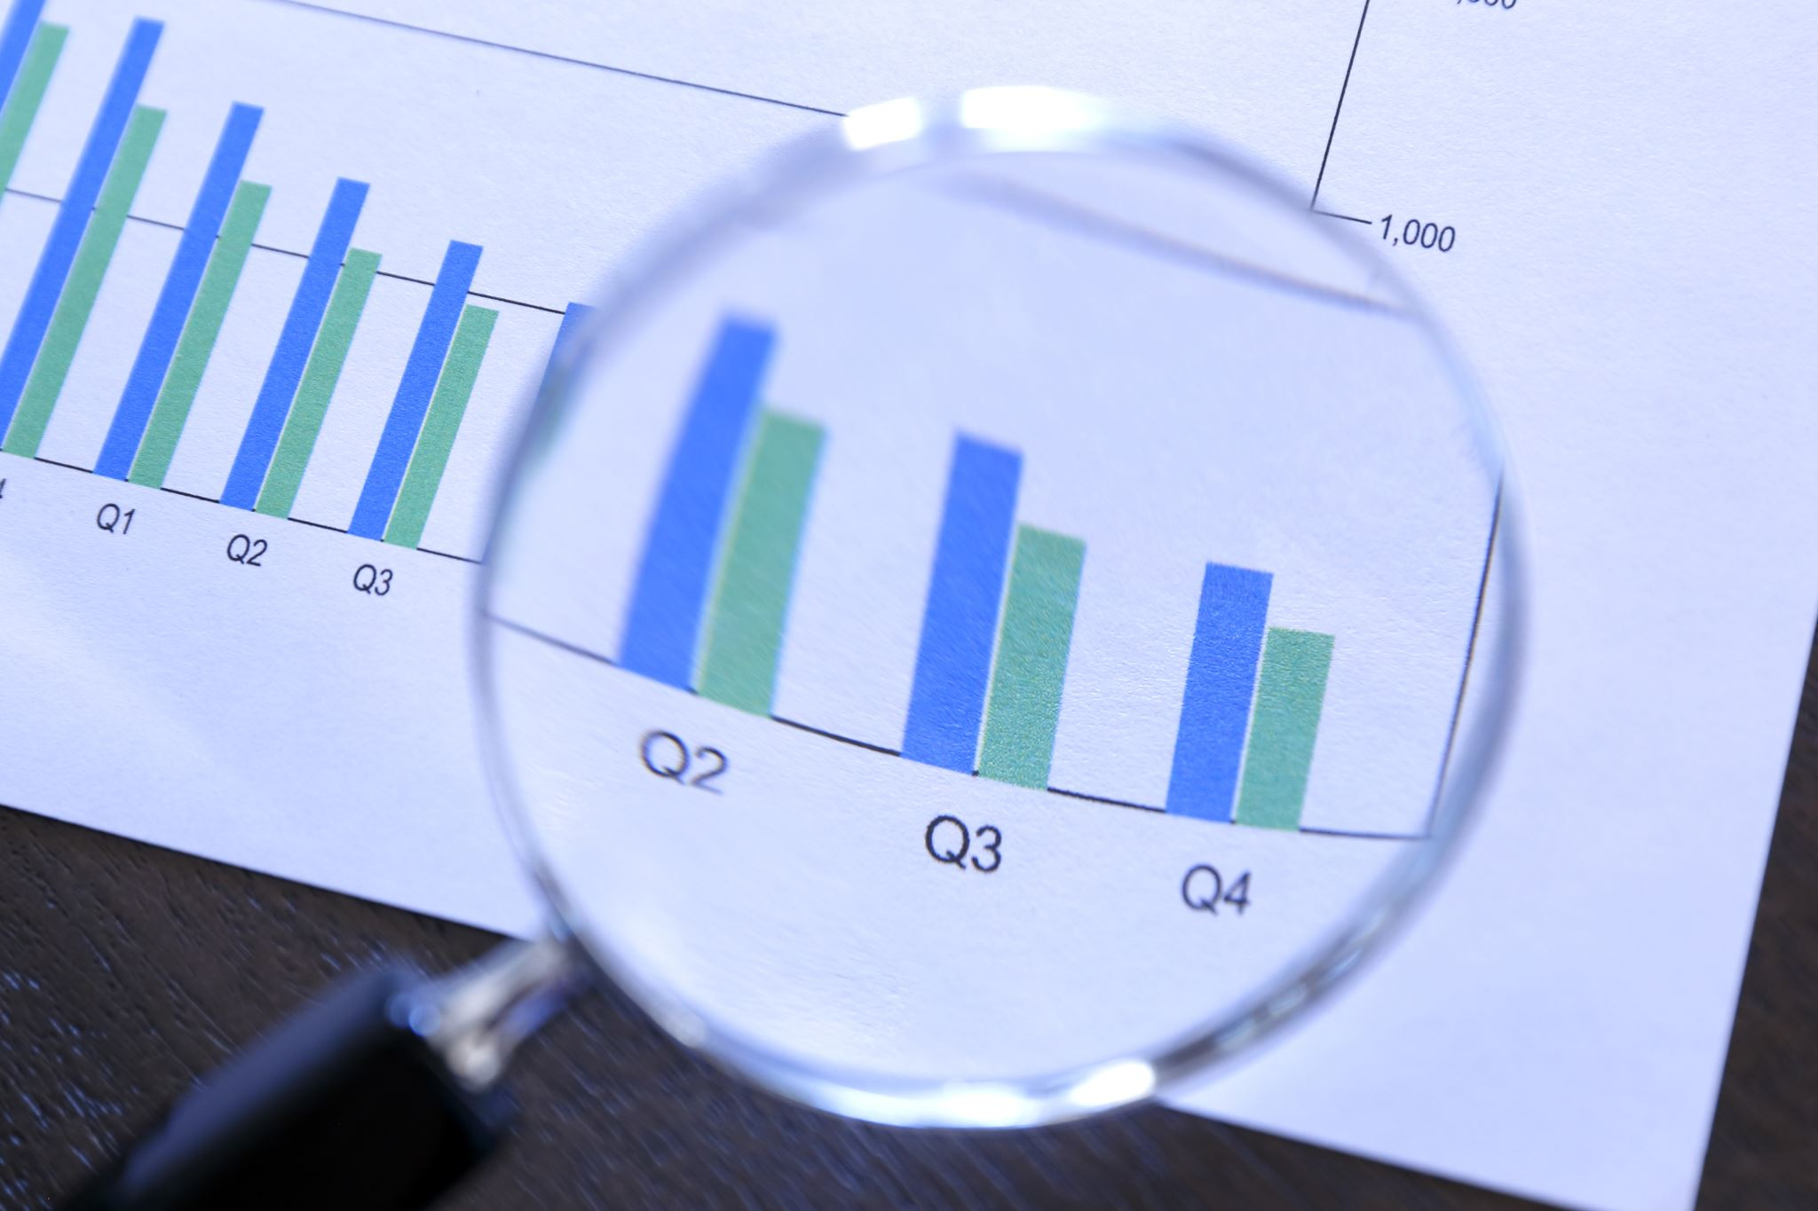
Key Findings & Business Impact
Key Findings:
Bill length and flipper length are strong predictors of body mass.
Species and sex have a significant influence on body mass distribution.
The linear regression model provides accurate predictions with minimal error rates.
Impact & Applications:
Assists biologists in monitoring and studying penguin populations.
Demonstrates how machine learning can enhance ecological and biological research.
Highlights the power of interactive applications for data-driven decision-making.

